Slide 1
Power BI Design

Slide 2
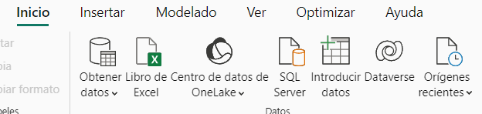
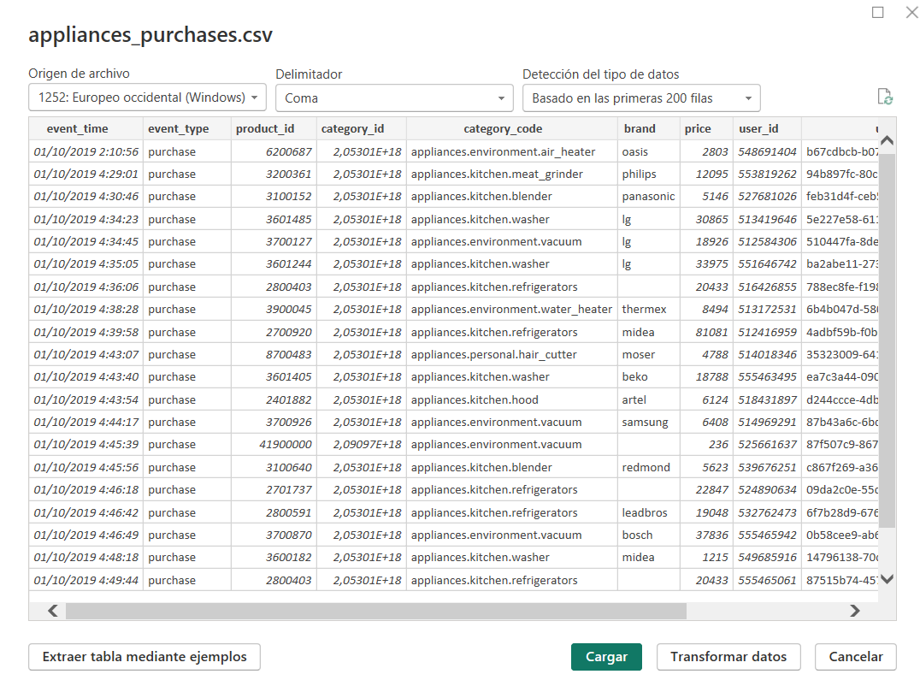
Upload de data
Steps:
Select the type of file
Select the file
Clicl on transform data if its necesary to change the format of any columna
Upload the file to power bi
*Note: you need to do this with every data base you want to upload.

Slide 3
Dashboard Nº1: Purchases

Slide 4
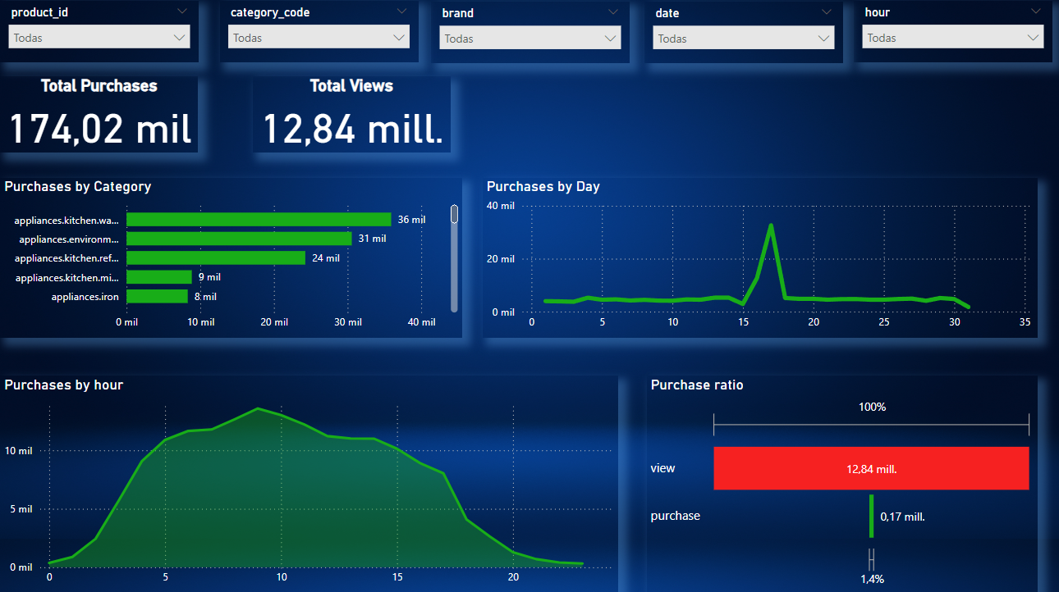

Slide 5


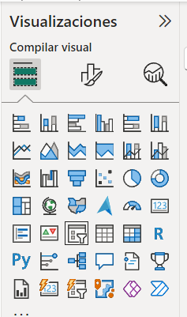
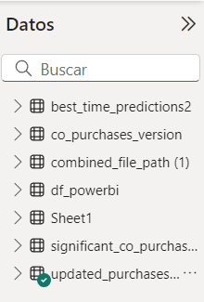
Category filters
Steps:
Select the “data segmetion” option on the visualization board
Select the specific category from the data base for each filter from de data setction.

Slide 6
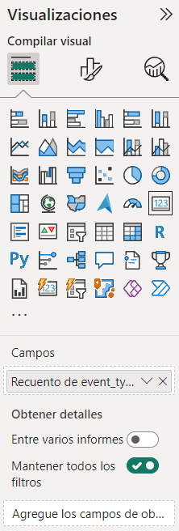
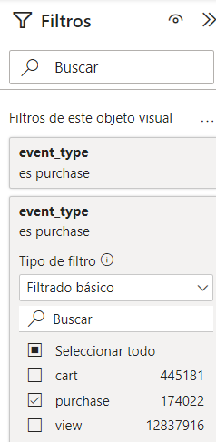
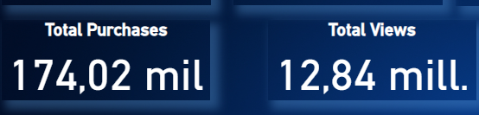
Cards
Steps:
Select the“card” option on the visualization board
Select the specific category from the data base for each card.
Add a filter to select the specific event type (purcharse or view)

Slide 7
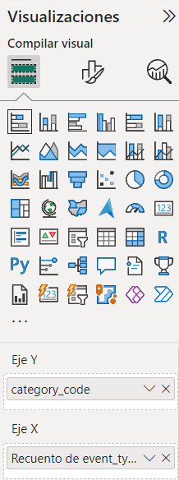
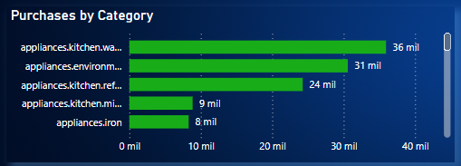
Graph Nº 1
This graph expalin the total purchases made by category and it is great to illustrate the difference between the categories.
Steps:
Select the “stack bar graph” option on the visualization board.
Select the variable category code for axis Y.
Select the variable event type (as a recount) for axis X.
Add a filter to select the specific event type (purcharse).

Slide 8
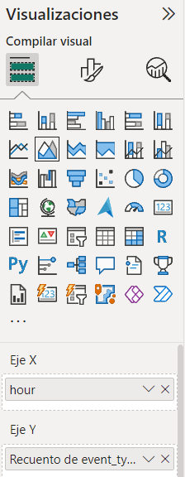
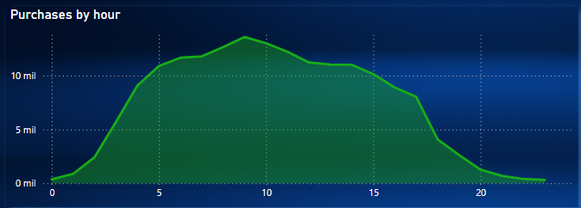
Graph Nº 2
This graph expalin the total purchases by hour and it clearly shows in what time of the day there were more purchases.
Steps:
Select the “área graph” option on the visualization board.
Select the variable “hour” for axis X.
Select the variable event type (as a recount) for axis Y.
Add a filter to select the specific event type (purcharse).

Slide 9
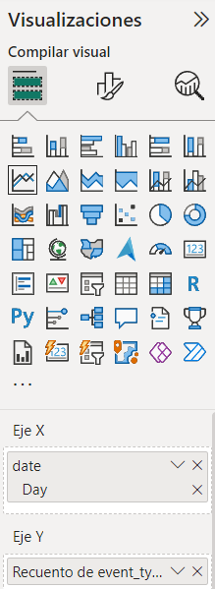
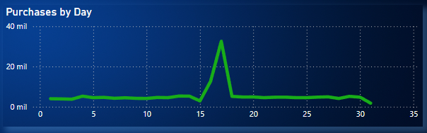
Graph Nº 3
This graphs expalin the total purchases made by day, it is very good to illustrate the difference of purchases in every day.
Steps:
Select the “line graph” option on the visualization board.
Select the variable “date” and choose the option “day” for axis X.
Select the variable event type (as a recount) for axis Y.
Add a filter to select the specific event type (purcharse).

Slide 10
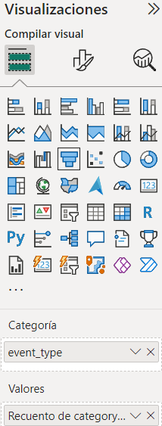
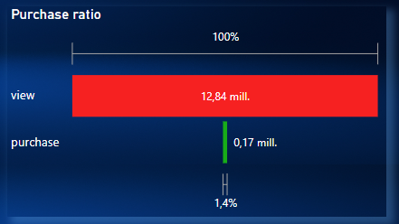
Graph Nº 4
This graphs expalin the purchase ratio considering the total views of the products, it Works very well to demonstrate the difference between each type of evento.
Steps:
Select the “funnel graph” option on the visualization board.
Select the variable “event type”.
Select the variable category code (as a recount) for the value option.
Add a filter to select the specific event type (purcharse).

Slide 11
Dashboard Nº1: Sales Prediction

Slide 12
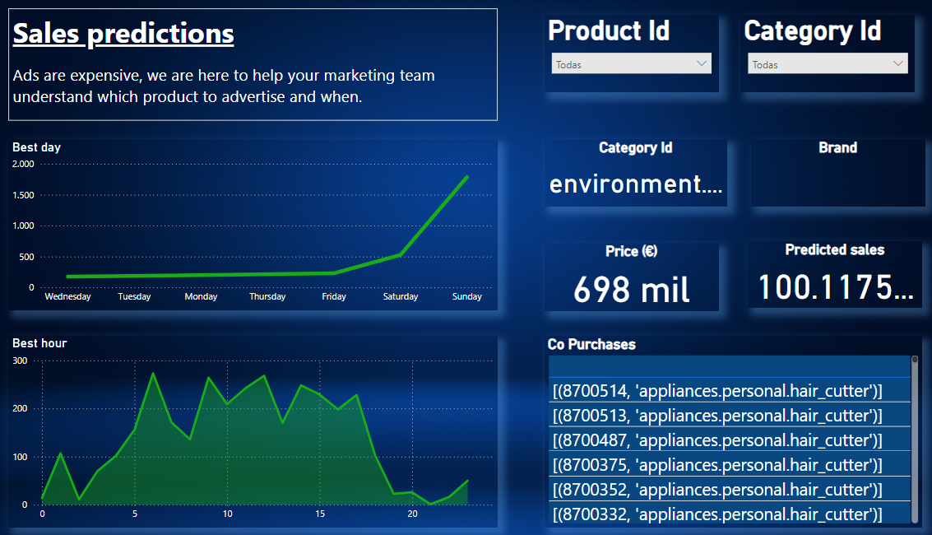

Slide 13
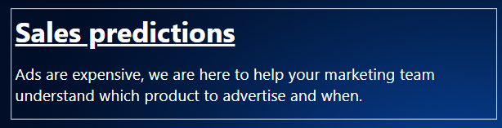
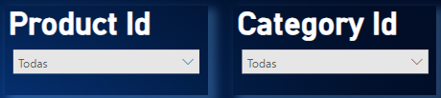
Text and filter categories
Steps:
Clic in “insert”
Select “text”
Steps:
Select “data segmetion” option on the visualization board
Select the specific category from the data base for each filter.

Slide 14
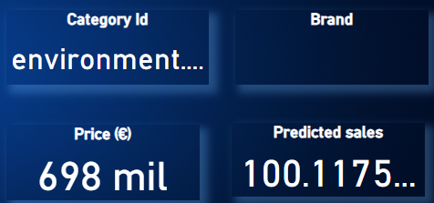
Cards
Steps:
Select the “card” option on the visualization board
Select the specific category from the data base for each card.

Slide 15
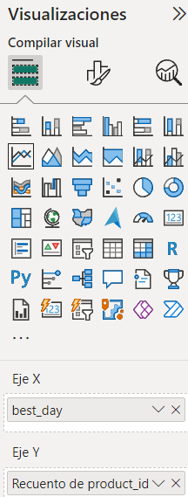
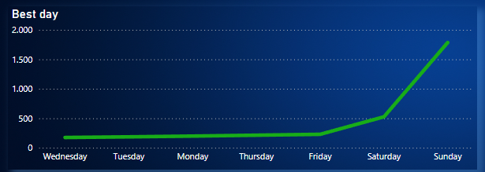
Graph Nº1
This graph expalin the prediction of the best day to promote the product selected.
Steps:
Select the “line graph” option on the visualization board.
Select the variable “best day” for axis X.
Select the variable “product id” (as a recount) for axis Y.

Slide 16
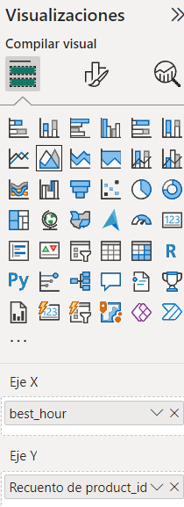
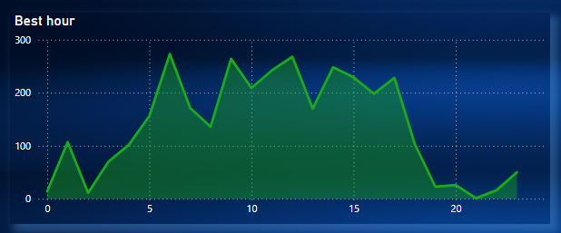
Graph Nº2
This graph expalin the prediction of the best day to promote the product selected.
Steps:
Select the “área graph” option on the visualization board.
Select the variable “best hour” for axis X.
Select the variable “producto id” (as a recount) for axis Y.

Slide 17
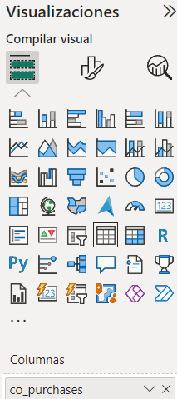
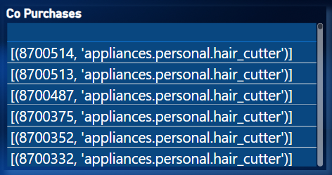
Graph Nº3
This graph expalin the recomended products to promote with selected product in order to increase co-purchases.
Steps:
Select the “table graph” option on the visualization board.
Select the variable “co_purchases” in the columna option.

